Slide 1
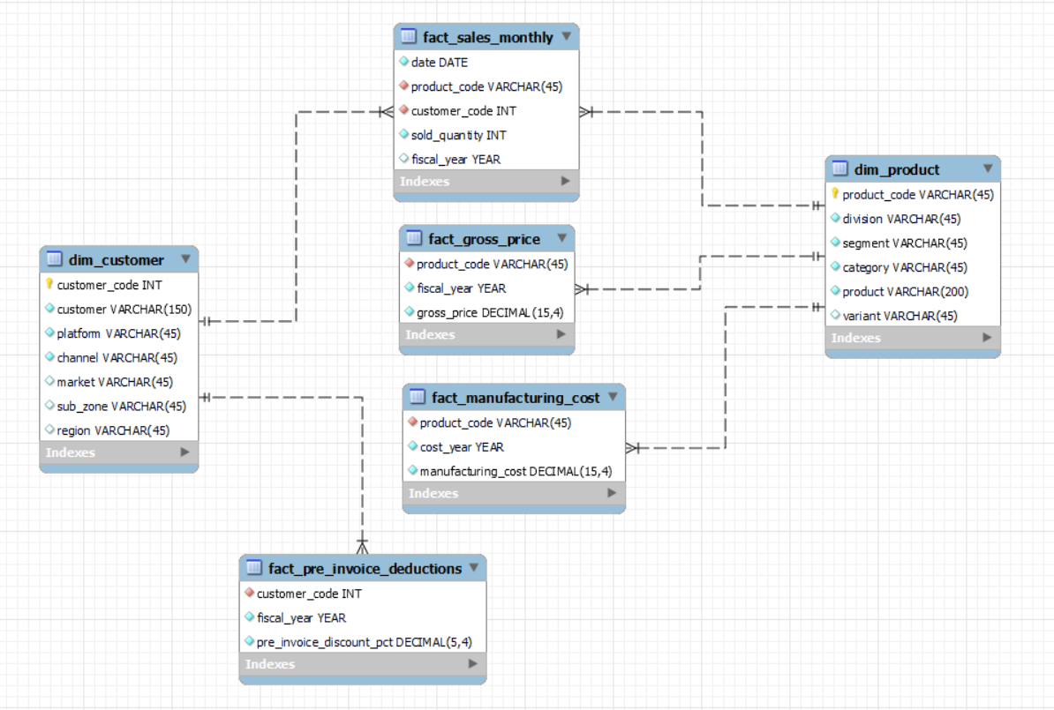
Entity Relationship Data Model

